Slide 1
Introduction To LaTeX
Alexandra Steiner - April 2020

Slide 2

What is LaTeX?
Latex is a free typesetting system that includes many features which make writing technical and scientific texts much easier
Latex consists of a single ‘compiler’ package that can process latex documents into pdf, xps, dvi, etc… formats.
The main latex package is supported by other, optional packages that can extend the functionality of latex (ie: add images, format proofs, create diagrams, etc…)
Latex Logo

Slide 3
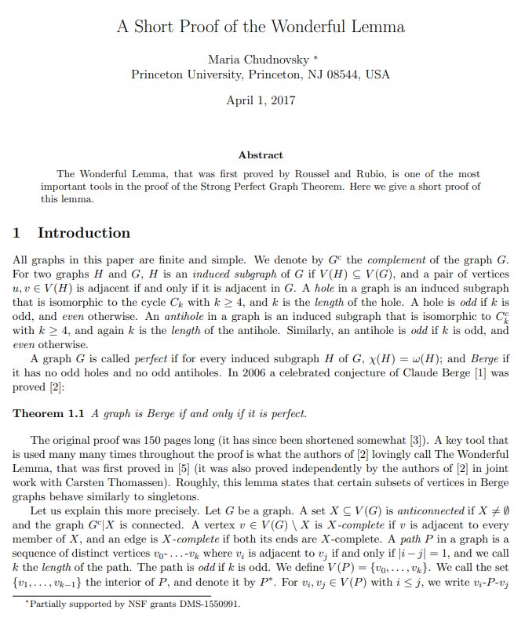
What is Latex used for?
Technical Documents and Scientific Papers

Slide 4
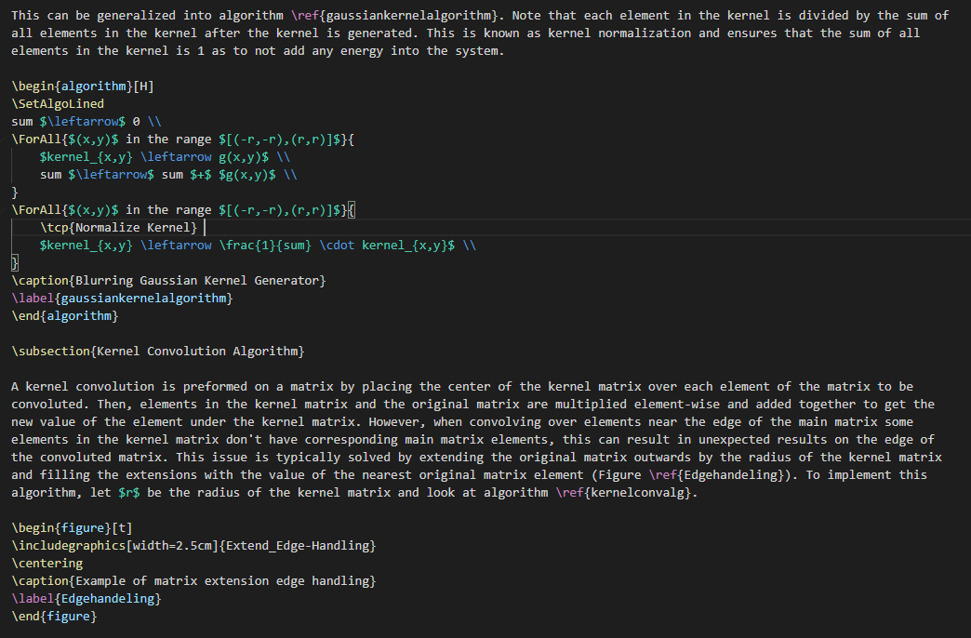
An example of LaTeX Code. This code can be compiled into pdf, dvi, and many other formats using LaTeX

Slide 5
Our Tools

Slide 6
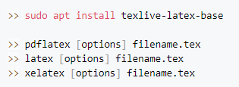
LaTeX on the Command Line
Needed for any latex editing applications. These applications simply execute specific command line commands for you
Large installation size (1.2GB to 5GB) depending on which packages are installed
MiKTeX is a good manager for command line LaTeX but outside the scope of this workshop

Slide 7
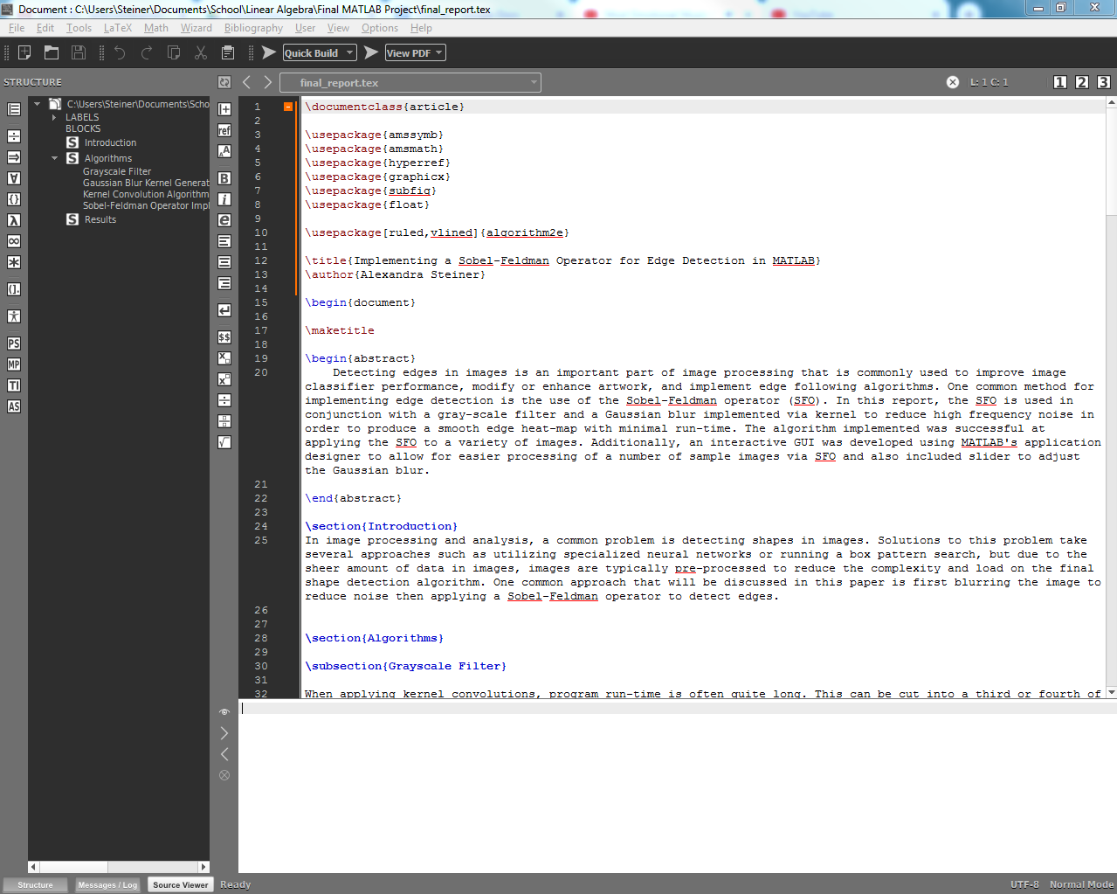
Texmaker
Desktop application
Needs command line LaTeX to run
Large installation size
Has spell-checking and suggestions built in

Slide 8
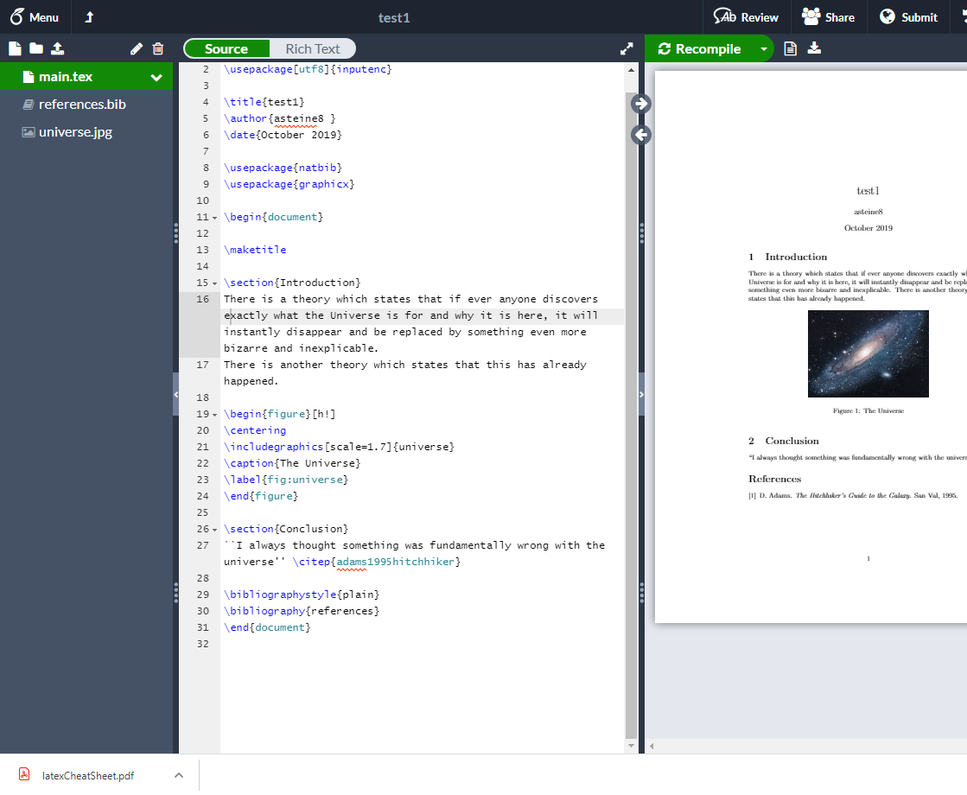
Overleaf
Online
Has spell-checking and suggestions built in

Slide 9
Writing LaTeX Documents

Slide 10
